Slide 1
Creating a Culture for Change
School/System Culture Survey
Notes:
This powerpoint provides an overview of the system/school culture survey.
Building and maintaining a positive culture should be every systems’ and schools’ goal. Positive school cultures provide safety, support, encouragement and healthy challenges for students and staff, which in turn fosters students’ academic achievement and growth. Positive school cultures increase satisfaction, morale, and effectiveness for the staff while simultaneously increasing learning, fulfillment, and well-being for the students (https://www.edglossary.org/school-culture/). School culture is the way things are done in the school - the personality of the school, with underlying norms and values. Culture and climate overlap and influence each other, however, climate can change rapidly (for better or worse), while culture goes deeper and takes longer to turn.
As part of the Kansans Can School Redesign Project, all Redesign Schools were asked to administer a School Culture Survey annually. During the summer of 2020, the KSDE Redesign Team worked with our state comprehensive center partners at McRel to recreate the culture survey based on existing surveys and research regarding schools as learning organizations (Elmore, Forman, & Stosich, 2016; Kools et al., 2020). The finished survey measures 5 Constructs of Culture, including: Shared Vision; Inquiry, Innovation, and Exploration; Collective Efficacy; Psychological Safety; and Modeling Learning Leadership.

Slide 2
What is ‘School Culture’?
Beliefs
Perceptions
Relationships
Attitudes
Written and unwritten rules
that shape and influence every aspect of how a school functions (The Glossary of Education Reform, 2020).
Notes:
https://www.edglossary.org/school-culture/
…but the term also encompasses more concrete issues such as the:
physical and emotional safety of students,
the orderliness of classrooms and public spaces, or
the degree to which a school embraces and celebrates racial, ethnic, linguistic, or cultural diversity.
School culture is the way things are done in the school - the personality of the school, with underlying norms and values.
Culture and climate overlap and influence each other, however, climate can change rapidly (for better or worse), but culture goes deeper and takes longer to turn.

Slide 3
Why is School Culture Important?
School culture is a key factor in student achievement and teacher retention.
Creating a happier place for people to work and learn will prevent more pressing issues from occurring.
Student attendance is better
Students’ behaviors are better
Teachers are less stressed
All have a growth mindset
Better outcomes for students
K-12 Dive Brief, 2018
Notes:
https://www.k12dive.com/news/creating-a-happier-school-environment-yields-benefits-for-students-and-teac/532036/#:~:text=A%20positive%20school%20atmosphere%20encourages,student%20achievement%20and%20teacher%20retention.

Slide 4
How do we evaluate school culture?
Shared Vision
Collective Efficacy
Inquiry, Innovation, and Exploration
Modeling Learning Leadership
Psychological Safety
Elmore, Forman, & Stosich (2010)
Kools, et al (2020)
Notes:
These constructs are not something we, at KSDE created. They are based on research regarding what it takes to make schools “learning organizations”.
Donohoo, Jenni, and Steven Katz. “What Drives Collective Efficacy?” What Drives Collective Efficacy? - Educational Leadership, ASCD, July 2019, www.ascd.org/publications/educational-leadership/jul19/vol76/num09/What-Drives-Collective-Efficacy%C2%A2.aspx.
Elmore, D. R. F., Forman, M. L., & Stosich, E. L. (2010). Internal Coherence Survey. 7.
Kools, M., Stoll, L., George, B., Steijn, B., Bekkers, V., & Gouëdard, P. (2020). The school as a learning organisation: The concept and its measurement. European Journal of Education, 55(1), 24–42. https://doi.org/10.1111/ejed.12383

Slide 5

Shared Vision
→ A ‘Shared Vision’ is a student-focused statement that is crafted with stakeholder feedback and centers around the premise that all students are capable of learning and achieving success.
Notes:
How might a ‘Shared Vision’ improve a building’s culture?
Truly a shared vision - each stakeholder can see their role in working towards the vision
Provides clarity/purpose amidst the whirlwind
Is the ultimate decision point - does this program/strategy align with our Vision, does it leverage the vision in a big way?
Reflects core values/beliefs such as ALL students can learn

Slide 6

Collective Efficacy
→ Collective efficacy is the belief that you, and your team, have the ability and authority to make a difference and/or have an impact. Staff believe that they can produce meaningful learning experiences for students and that they can repair gaps in student learning. The belief in your own, or your groups’, potential.
Donahoo & Katz (2019)
Notes:
When we talk about collective efficacy, we are talking about all staff believing that they, as individuals, and that they, as members of a team, have the ability and the authority to make a difference. All staff believe that they, and the larger team, can have an impact on the work being done and the people whom the work directly reaches.
When collective efficacy exists, staff believe that they can create and produce meaningful learning experiences for students. Teachers and staff believe that they can address and repair gaps that students might have in their learning.
Donohoo, Jenni, and Steven Katz. “What Drives Collective Efficacy?” What Drives Collective Efficacy? - Educational Leadership, ASCD, July 2019, www.ascd.org/publications/educational-leadership/jul19/vol76/num09/What-Drives-Collective-Efficacy%C2%A2.aspx.
Elmore, D. R. F., Forman, M. L., & Stosich, E. L. (2010). Internal Coherence Survey. 7.
Kools, M., Stoll, L., George, B., Steijn, B., Bekkers, V., & Gouëdard, P. (2020). The school as a learning organisation: The concept and its measurement. European Journal of Education, 55(1), 24–42. https://doi.org/10.1111/ejed.12383

Slide 7

Inquiry, Innovation, and Exploration
→ School staff are encouraged to take initiative, ask questions, think differently, and solve problems in new or unique ways. Staff value their own growth and learning and take calculated risks in order to improve student outcomes.
Notes:
How might ‘Inquiry, Innovation, and Exploration’ improve a building’s culture?
Inquiry = Curiosity
Innovation = thinking & behaving differently
Exploration = calculated risks, safe enough to try

Slide 8

Modeling Learning Leadership
→ Leaders continue to grow and learn through professional development and coaching. Leaders encourage staff and students to participate in decision-making, and they develop the leadership potential in others. Leaders model effective practice and work to build and maintain trust.
Notes:
Shared Leadership
Flattening of the organization, elevating voice of teachers AND students (not just beneficiaries but participants in the learning process)
Foundation of trust is the key to shared leadership and decision-making (not waiting around for hierarchical approval, if it fits the Vision and core values/beliefs - just do it)

Slide 9

Psychological Safety
→ Staff utilize the mindset ‘safe enough to try’, and share their learning with others about what does and does not work. Staff utilize the mindset of ‘failing forward’, and mistakes are viewed as learning opportunities. Staff feel safe to speak their truth and engage in collegial discourse.
Kim & Gonzalez (2018)
Notes:
The next construct is psychological safety. Psychological safety is when staff are able to use the mindset of ‘safe enough to try’ when it comes exploring and testing new ideas. This idea of ‘safe enough to try’ comes from the book The New School Rules Anthony Kim and Alexis Gonzalez. In psychologically safe environments, staff share their learning with others, and they ‘fail forward’...another concept from The New School Rules. When failing forward, mistakes are viewed as learning opportunities and staff feel safe enough to speak their truth and engage in collegial discourse to move forward.

Slide 10

Moving to Mentoring
Schools that are at a mentoring level in school culture are not only focused on their school’s data, but actively seek out ways to collaborate, share and learn with external stakeholders, schools outside of their district, and institutions of higher education.
Notes:
When we think about schools that are interested in becoming a learning organization, there must be a desire to move towards mentoring. Moving to mentoring means that you are not only focused on your own data and measures of success, but you are also focused on collaborating with others. You seek out opportunities to share and learn with and from externals stakeholders. You look around and outside or your own district and you seek to learn from and work with institutions of higher education. Moving to mentoring means you are continuously focused on improving through the strategic growth of your network and circle of influence.

Slide 11
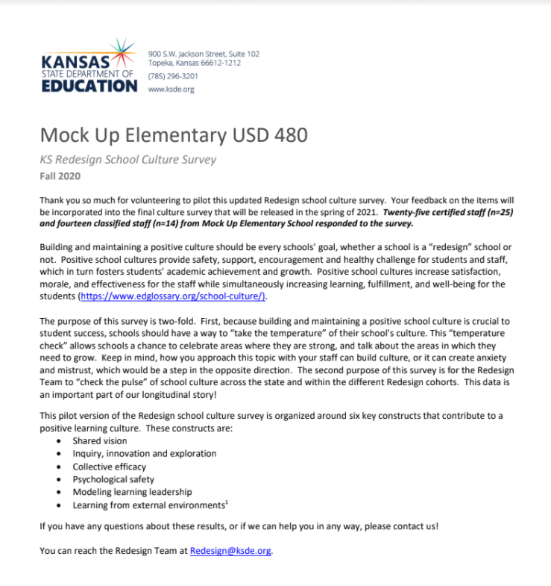
School Report
Individualized School Report Sample
Notes:
After your staff have completed the culture survey, you can request an individualized school report from KSDE. This individual report begins with an introduction summarizing culture and the various constructs evaluated in the survey before giving you an in-depth picture of how you fair in each construct. Take a moment to review the sample report by clicking on the hyperlink in the slide deck.
Once you have your report, you will then want to utilize our ‘culture toolkit’ to help facilitate reflection and action planning around each culture construct. That culture toolkit will be shared with you with your school’s individualized report.

Slide 12
Culture Survey Timeline
Send the ‘why’, directions, and link to your staff and have them complete it during the months of March/April 2023.
  We recommend that you give a two week window to ensure completion.
Have the principal/district lead email accreditation@ksde.org to request a copy of your data.
  Please do this before May 12, 2023.
Individual reports will be sent back within 1 week of the request.
Notes:
Let’s take a moment to review our timeline. During the months of March and April, we are asking that you share the culture survey with staff and request their participation.
Some tips for administration include, limiting the window for completing survey; sometimes a shorter deadline, like 1 or 2 weeks instead of 3 or 4 is helpful. You consider having a ‘did you do the culture survey’ form and offer a celebration upon reaching 100% of staff participation.
Once you have completed the survey, you must contact the accreditation team by emailing accreditation@ksde.org to request your report. Please make sure we know your district name and number and your school name. Please make sure we also know who to send the report to once it is ready. Please request your report by May 12. These must be created and curated individually, so our commitment is to have those back to you within one week.
Upon receiving your survey results, you will also receive our culture survey toolkit. The toolkit is meant to help you break down the survey results and generate next steps for improving your school’s culture.

Slide 13
  Accreditation and Design Team
  (785) 296-8012
  accreditation@ksde.org

